Slide 1

Glia Cells: Capturing Human Intelligence in AI Systems
Prof. Liam McDaid
CNET Team, ISRC
Ulster University, Derry
Northern Ireland

Slide 2
Content
History of AI
AI research focus
AI vs brain-like intelligence
AI in self-driving cars
Neural – Glia interactions
Concluding remarks

Slide 3

History of AI
1940’s - Paper proposed the McCullough - Pitts Neuron
1950’s - Alan Turing proposed the Turing Test, a method for determining if a machine is intelligent
1960’s - John McCarthy opens AI Lab at Stanford – proposed self-driving cars
1970’s - PROLOG was created – used in expert systems

Slide 4
History of AI
1980’s - Digital Equipment Corporations develops XCON, the first successful commercial expert system
1990’s - IBM's Deep Blue beats world chess champion Gary Kasparov
2000 - A self-driving car wins the DARPA Grand Challenge
The U.S. military begins investing autonomous robots
Google makes breakthroughs in speech recognition in its iPhone app

Slide 5
History of AI
2010 - Google Brain Deep Learning project – a deep learning algorithms trained to recognize a cat
Google makes first self-driving car to pass driving test
Amazon's Alexa is released
Google DeepMind’s AlphaGo defeats world champion Go player Lee Sedol - seen as a major breakthrough in AI.
The first robot citizen (Sophia) - capable of facial recognition, verbal communication and facial expression.

Slide 6
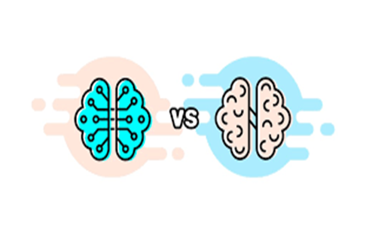
AI vs Human Brain
Human brain - away ahead of AI in terms of intelligence
Ability to store and process information/shapes
Brain – complex networks – creative and communicative
An important area of research is new computing machines - Neuromorphic Engineering - however relatively small effort
Research mainly focused on understanding brain diseases - deterioration of brain function

Slide 7
AI Research Focus
AI - replicating human intelligence in robots, cars, drones, etc
Problem – AI can’t easily recognize human faces/objects
Goal of AI is computer systems that can:
Learn in a human-like way
Process images in a human-like way
Be creative/communitive in a human-like way

Slide 8
Problems to be overcome in AI
What does AI have to achieve to truly mimic brain intelligence
AI needs to capture the way the brains represents objects?
AI machines must reduce energy requirement - brains use about 20 watts to cover our entire thinking ability
AI must work with data fragments and uncertain data
AI needs to run on hardware to achieve parallelism

Slide 9
Can AI Capture Brain-Like Intelligence
Is it possible that computers surpass the capability of human brains within the next 30 years
Unlikely – Current understanding of brain function is very limited
Don’t really understand neurons – learning – object representation
Don’t really understand signalling between or within cells
Cells other the neuron are also poorly understood – Astrocytes, Microglia, obigodendrocytes

Slide 10
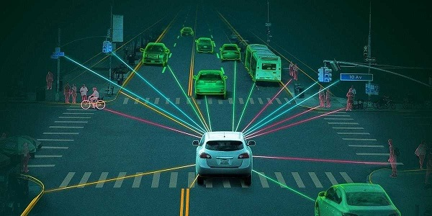
AI in Self Driving Cars
Self driving cars – uses a combination of sensors, cameras and radar
Google - first company to create a car with full autonomy (in 2012) — no pedals or steering wheel
Problems – dynamic map of surroundings - road marking, road conditions (snowing, raining), relative position of vehicles/people continually changing

Slide 11
What Now
Deepen our understanding of brain function at:
Intercellular Level - DNA to RNA to Proteins to Membrane Transporters
Cell Level – Cell to cell signalling between different cell types – Neurons and Glia
Small Network Level – hundreds of neurons interacting with different cell types – Neurons and Glia
Large Network Level – hundreds of thousands of neurons interacting with long and short range signalling

Slide 12

What Now
Requires concerted effort over many years from:
Neuroscientists/experimentalists – develop new experimental techniques
Modellers – capture intercellular and cell to cell signalling at small/large network level
cognitive scientists – study intelligence and behaviour - focus on how nervous systems represent, process, and transform information

Slide 13
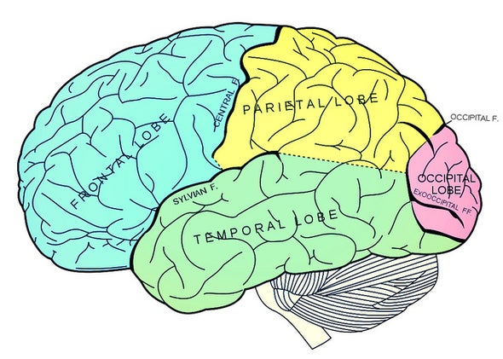
Processes sensory information from the outside world: touch, taste, and temperature
Brain Regions
Behaviour and emotional control centre
Primarily responsible for visual processing
Process emotions, language, and certain aspects of visual perception

Slide 14
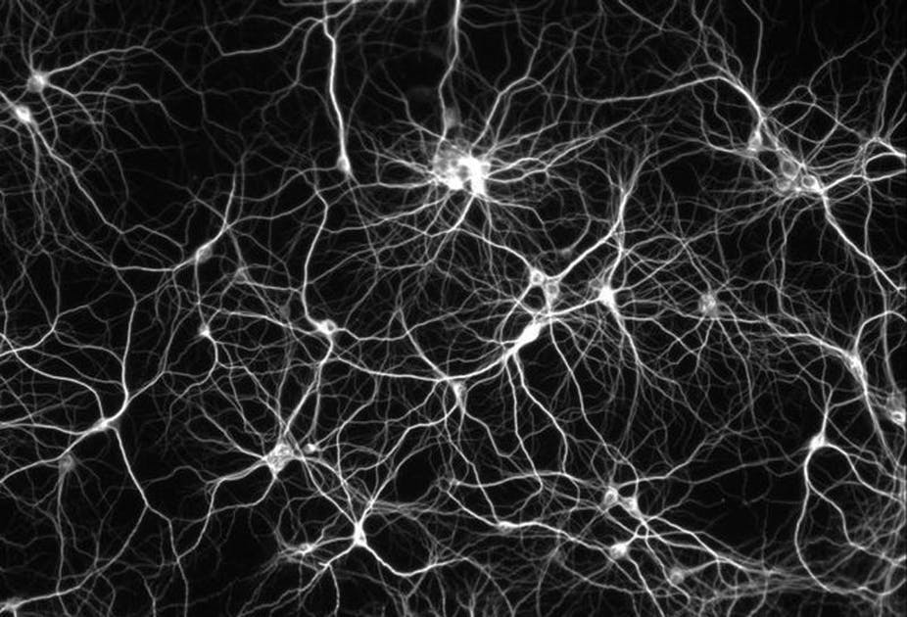
Cartoon Image of Brain Network

Slide 15
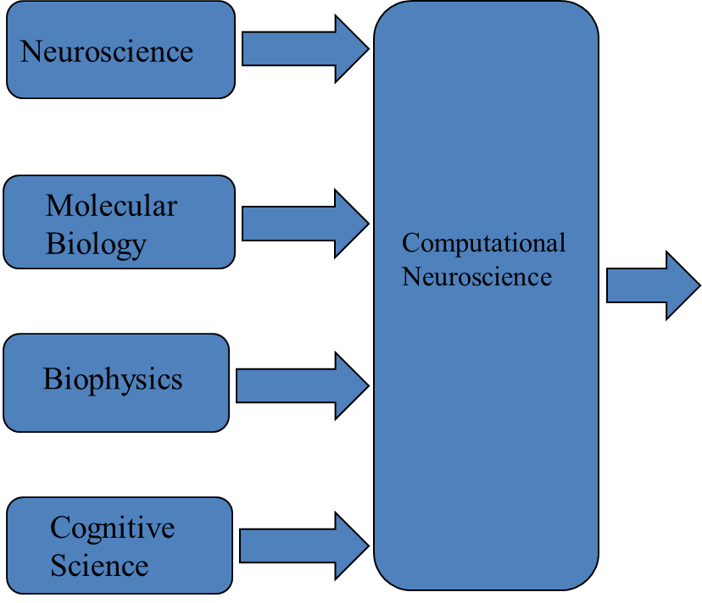
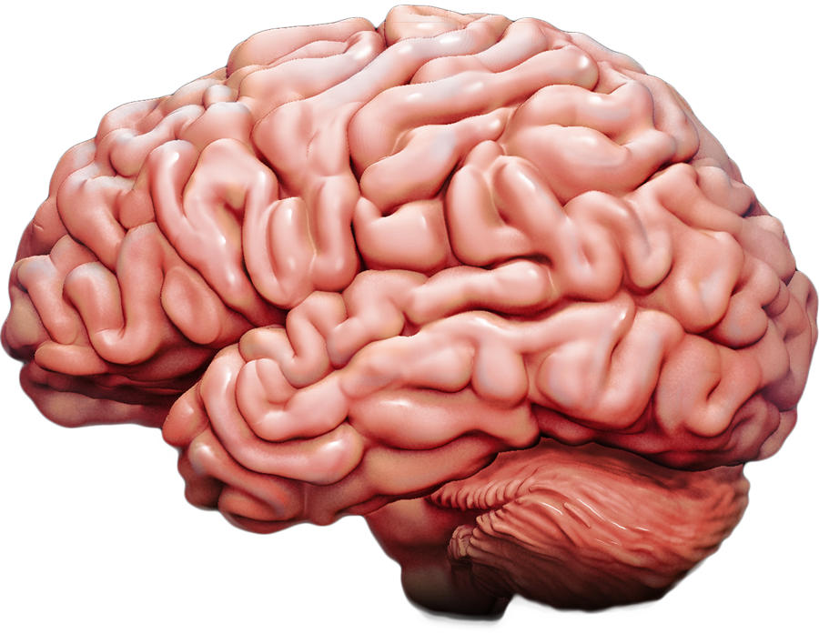
Computational Neuroscience - ?

Slide 16



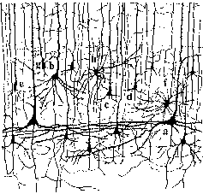
Neural Network Model

Slide 17
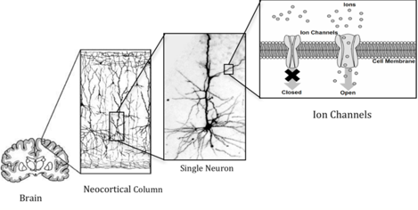
Model Abstraction Level

Slide 18
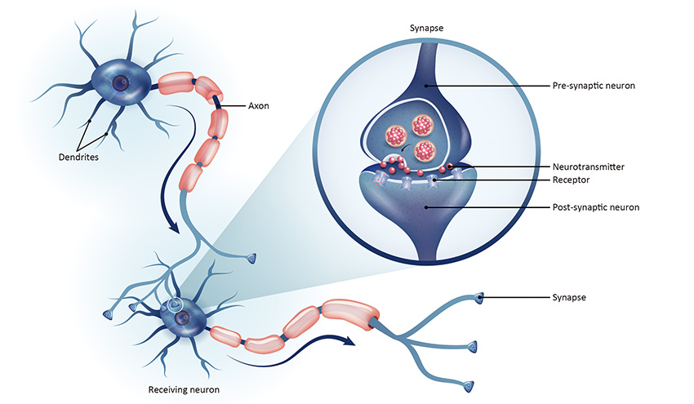
Synaptic Junction between two Neurons

Slide 19
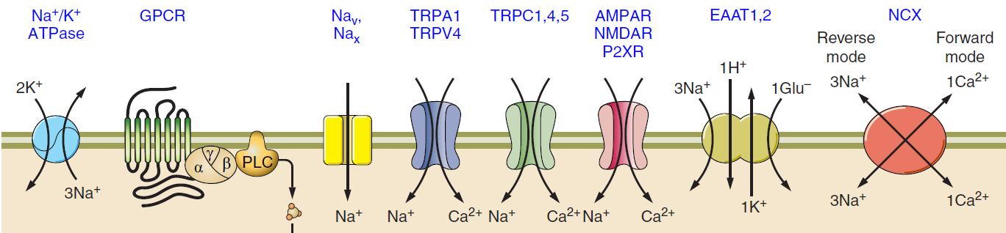
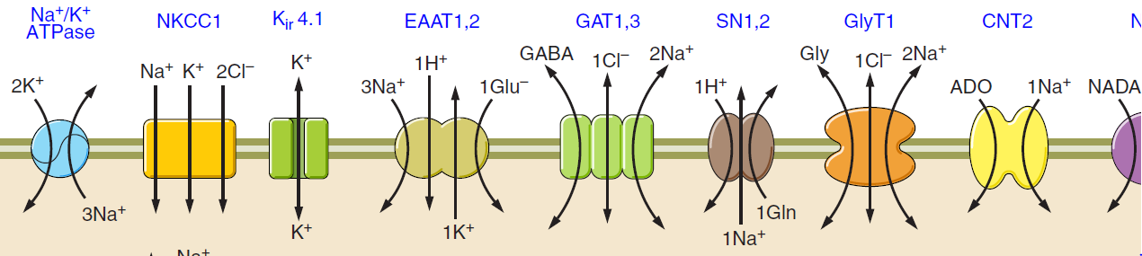
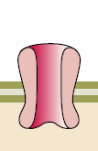
Ionic Transport Across Cell Membranes
VGCC
Ca²⁺
Reference: Verkhratsky A, Nedergaard M. Physiology of Astroglia. Physiol Rev 98: 239–389, 2018. doi:10.1152/physrev.00042.2016.

Slide 20
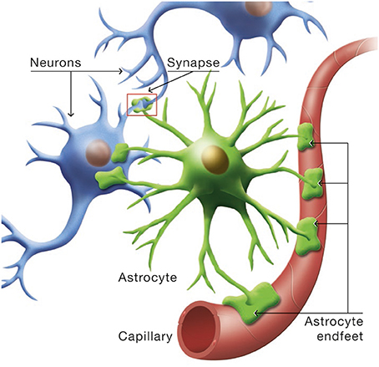
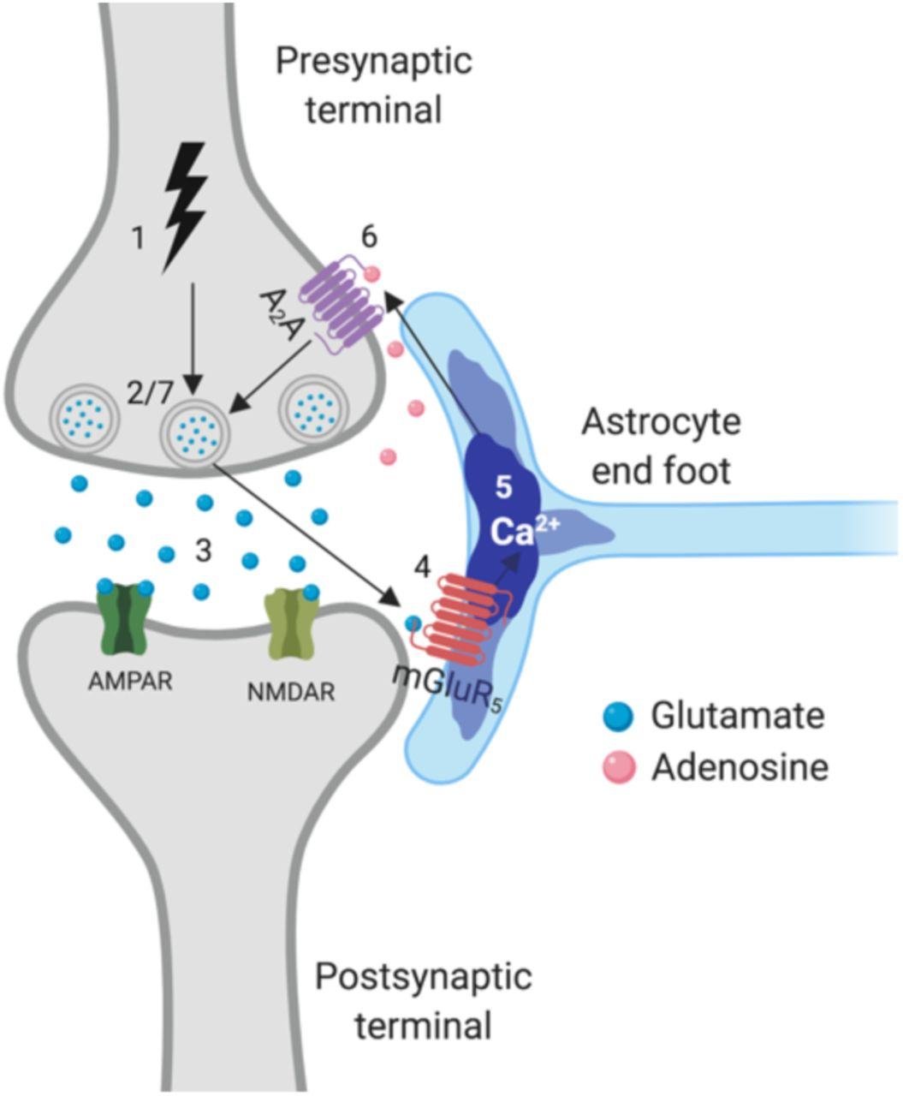
New Player-Astrocyte
Astrocytes - type of glial cell that enwraps neuronal synapses
Astrocytes semi-isolate synapses
Homeostatic control of different ionic species like Ca²⁺, Na⁺ and K⁺
Thin processes (∽50nm) play a crucial
role in ionic flow – effectively semi-isolate
cradle from soma
Image taken from [4]

Slide 21

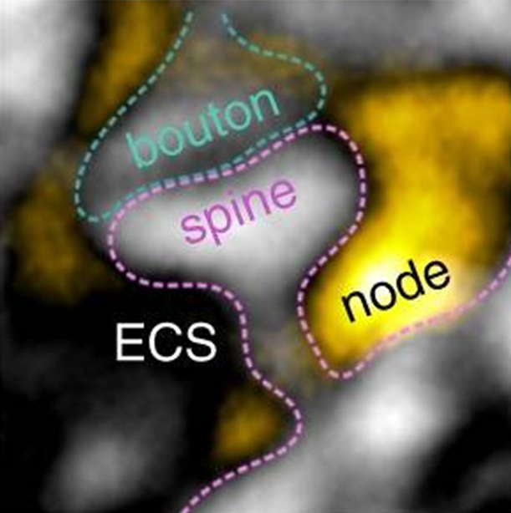
Astrocyte Coverage at Tripartite Synapses

Slide 22
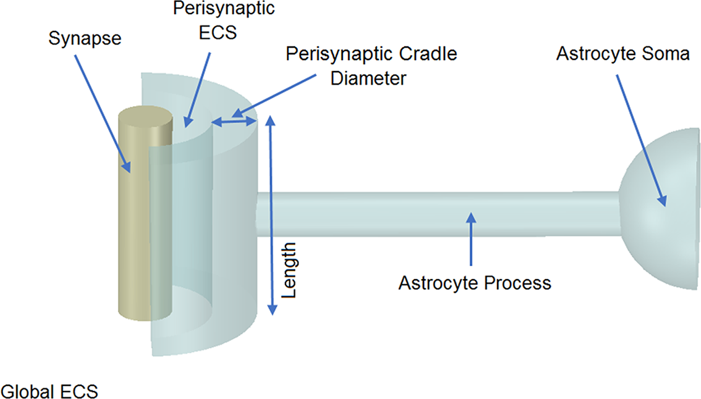
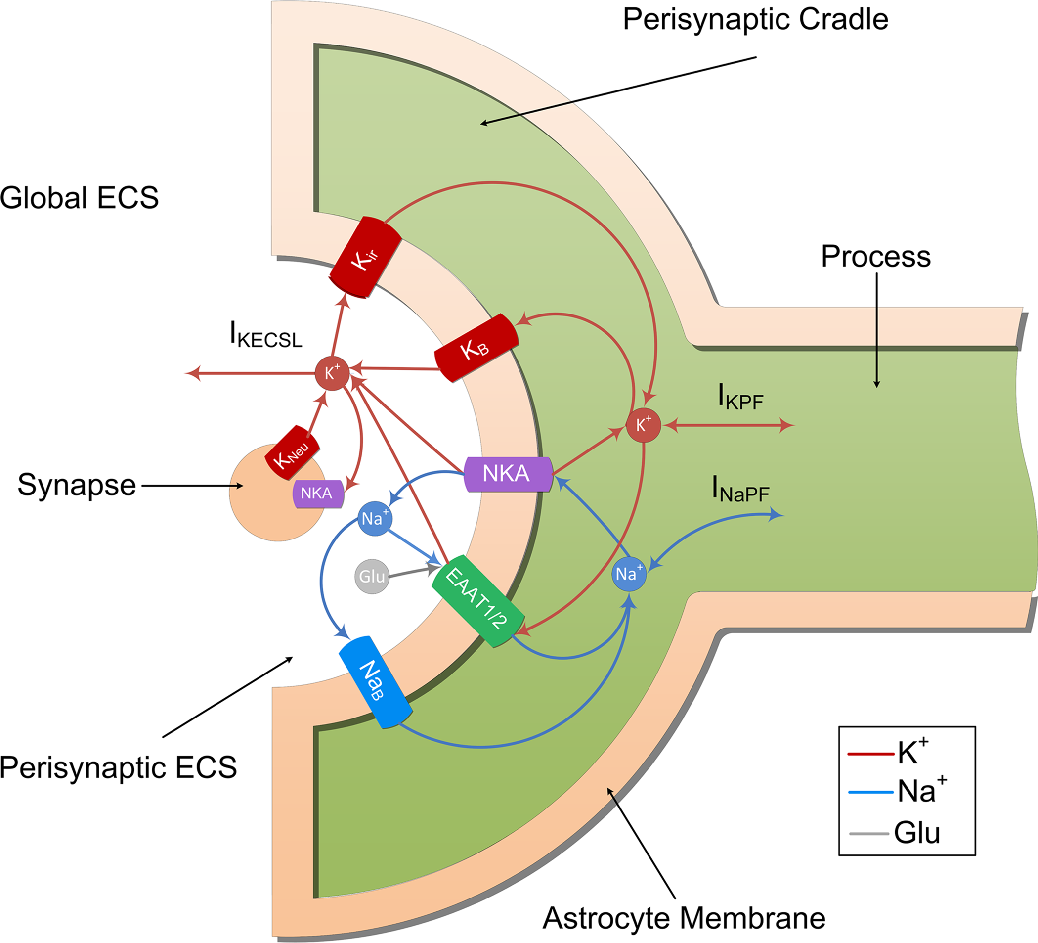
Tripartite Synapse Model

Slide 23
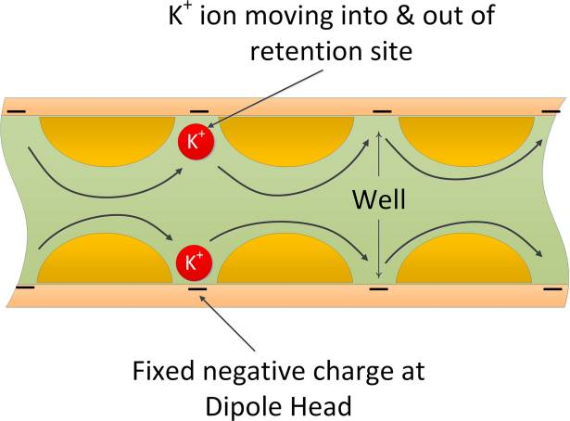
Retention Sites in Thin Processes

Slide 24

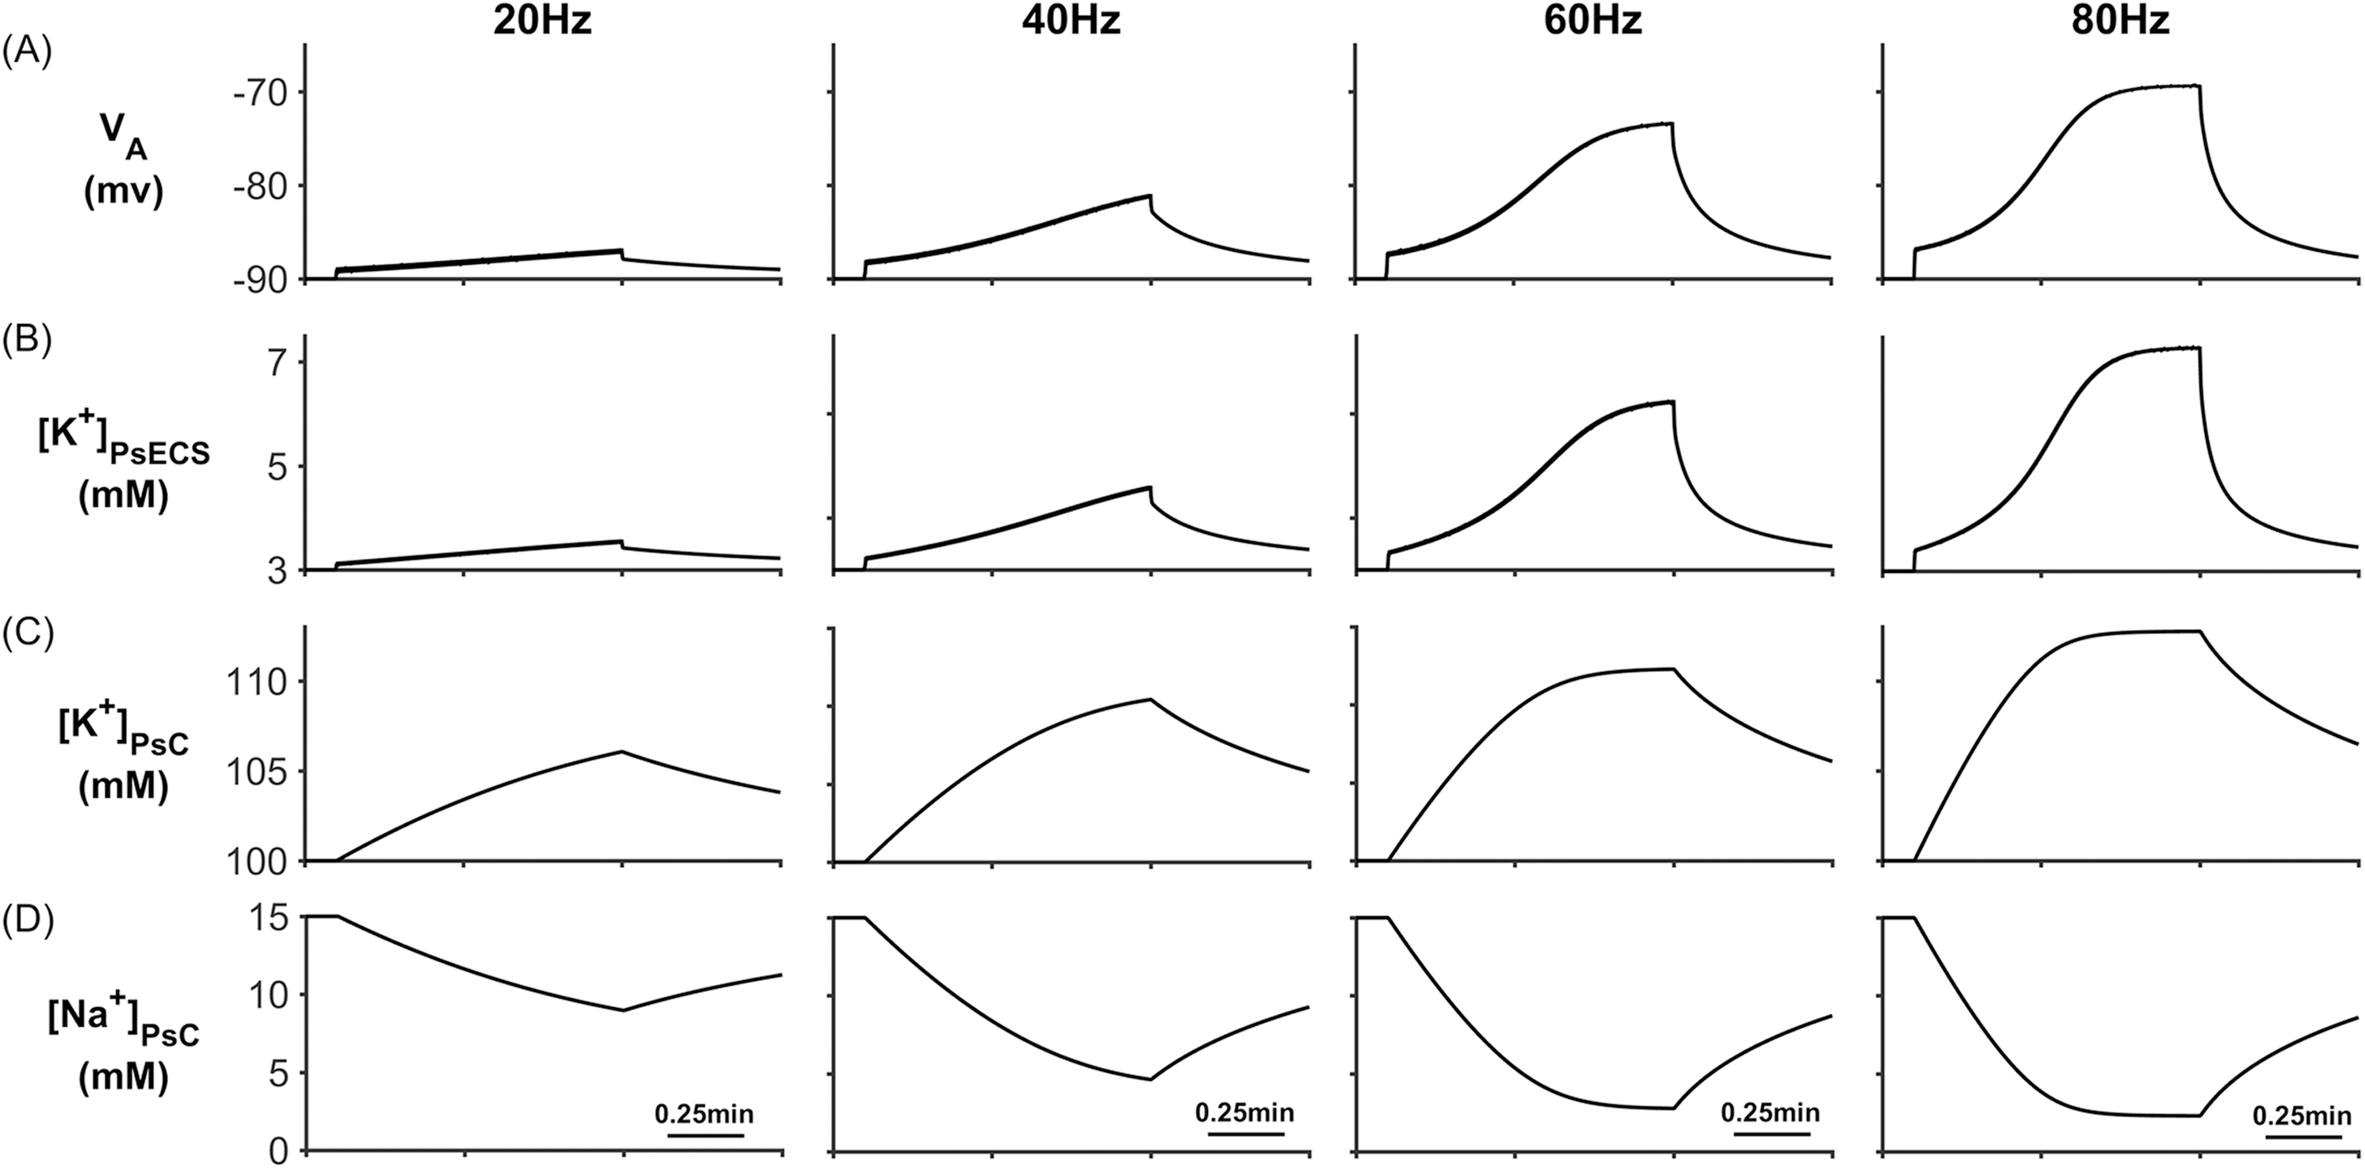
Potassium Buffering
Microdomain

Slide 25
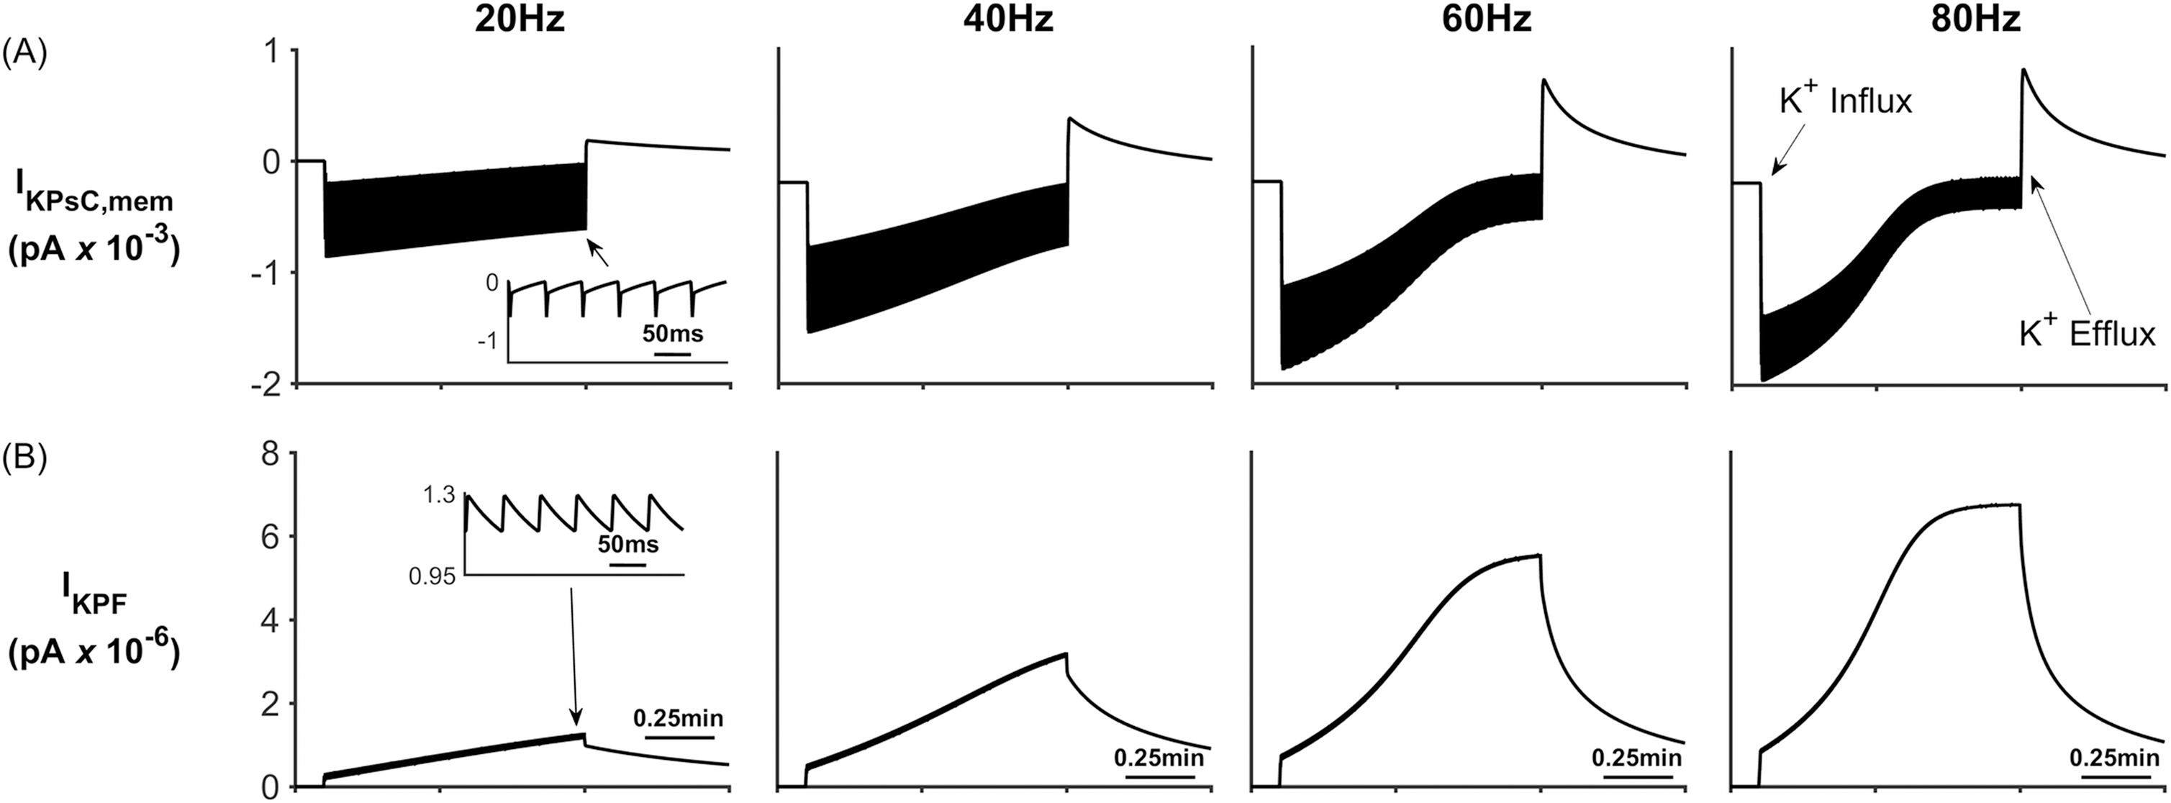
Potassium Buffering

Slide 26
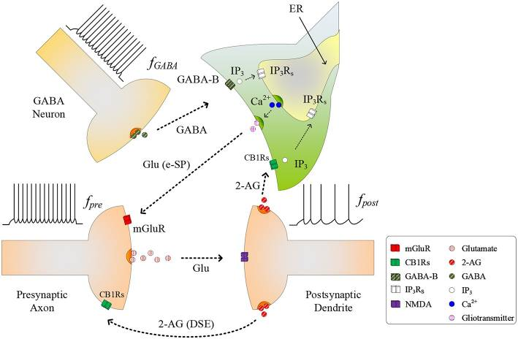
GABA Interneurons - Tripartite synapse

Slide 27
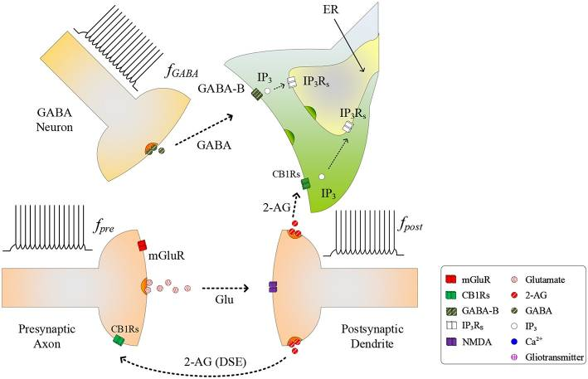
GABA Interneurons - Tripartite synapse

Slide 28
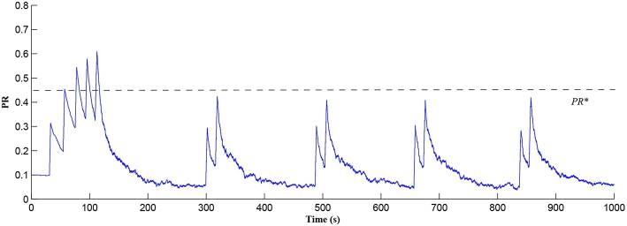
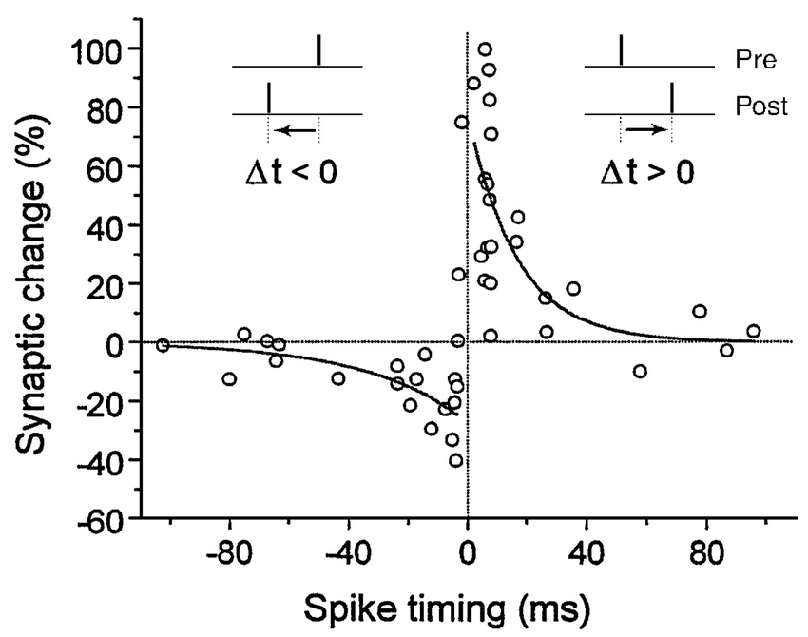
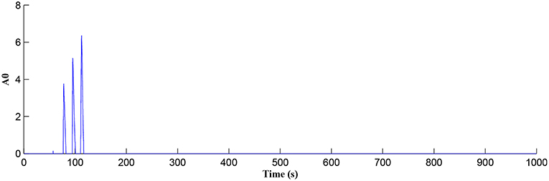
STDP - Synaptic Potentiation

Slide 29
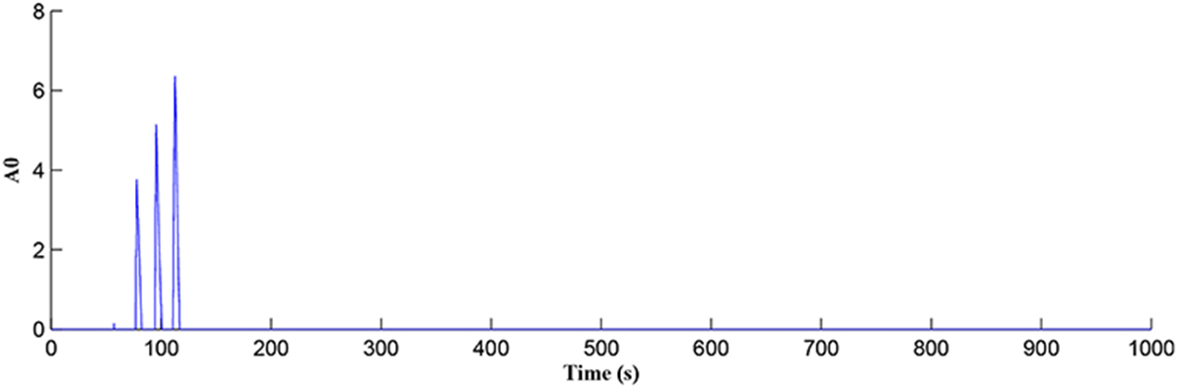
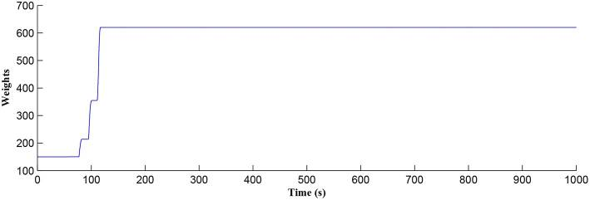
Weight Potentiation When STDP Window Open

Slide 30
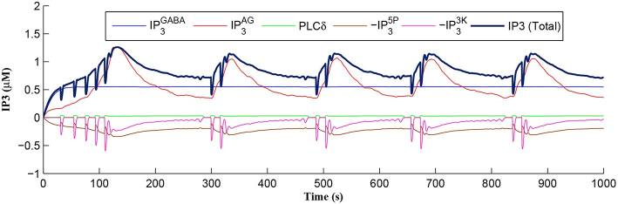

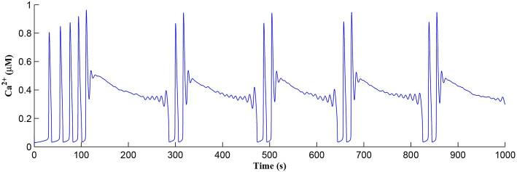
Calcium Oscillations

Slide 31
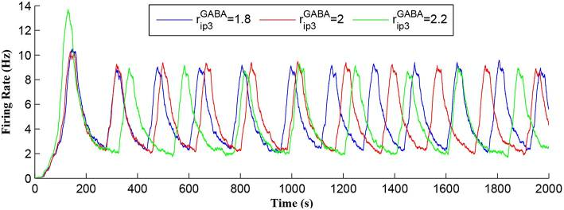
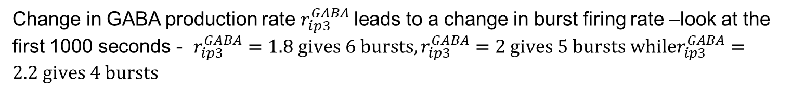
Neuronal Burst Firing
Change in GABA production rate $r_{ip3}^{GABA}$leads to a change in burst firing rate –look at the first 1000 seconds - $r_{ip3}^{GABA}=1.8 gives 6 bursts,r_{ip3}^{GABA}=2 gives 5 bursts whiler_{ip3}^{GABA}=2.2 gives 4 bursts$

Slide 32

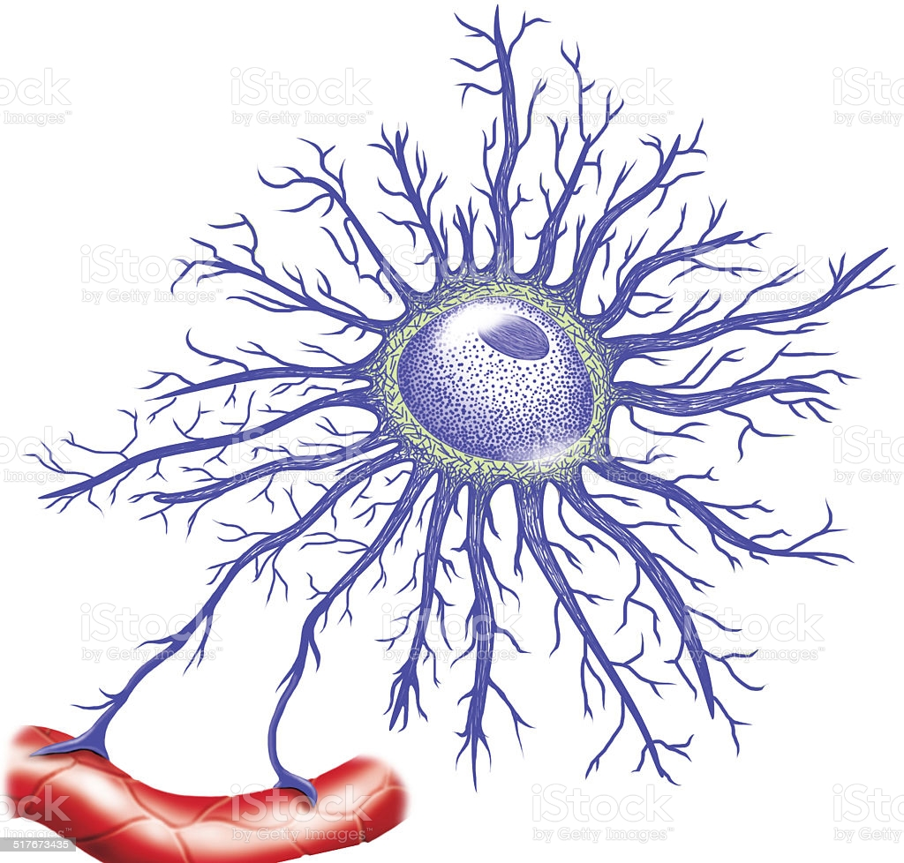
Astrocyte Primary & Thin Processes

Slide 33
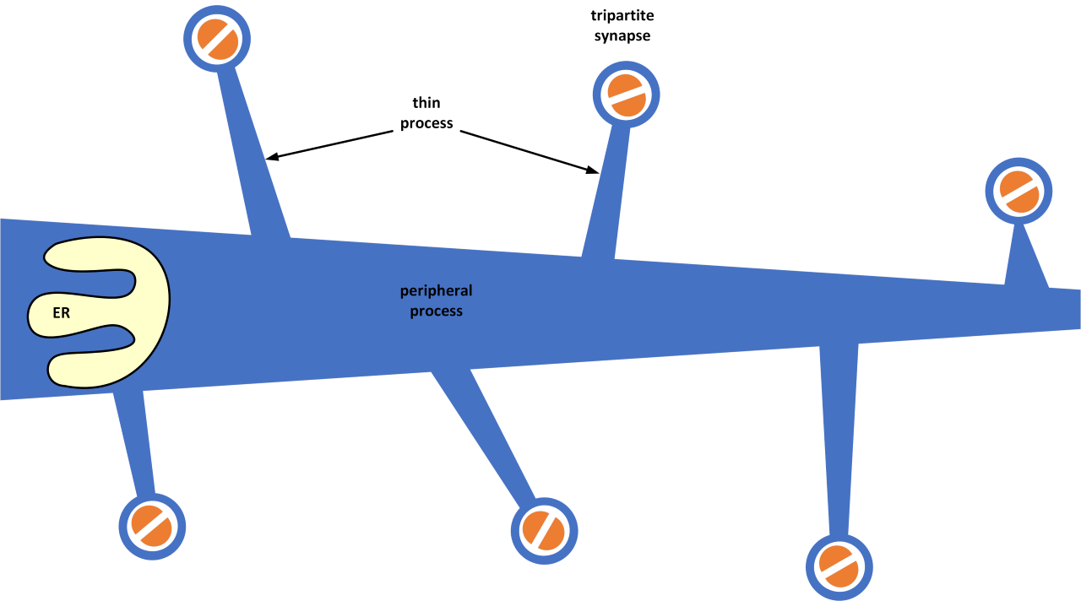
Model of Primary & Thin Processes

Slide 34
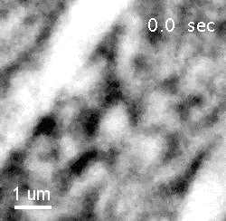

Slide 35
Discussion
Highly unlikely that AI captures brain function in the foreseeable future
Current AI very loosely replicates brain function due to our limited understanding at cellular or network level
Much more research is needed into brain function to move AI forward
Research is still trying to understand the complexities involved in cell to cell signalling
Truly brain inspired AI based autonomous systems is still a long way off

Slide 36
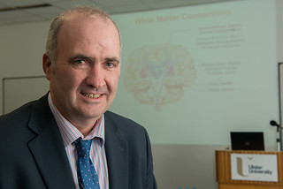

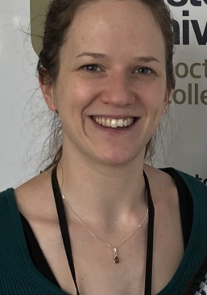
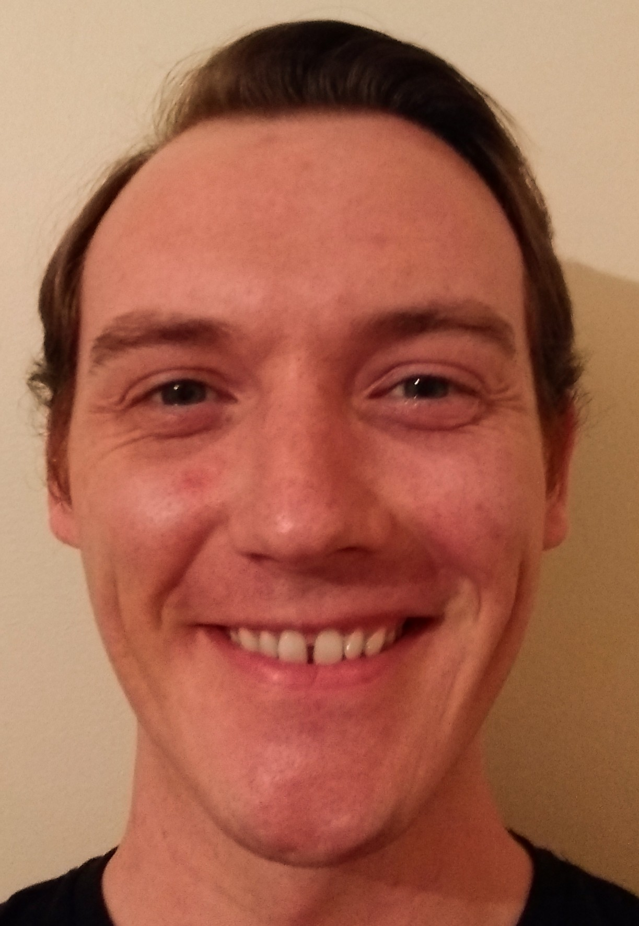
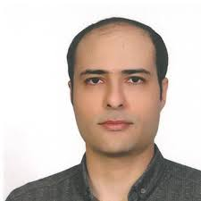



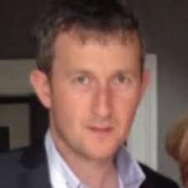
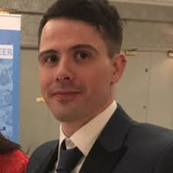
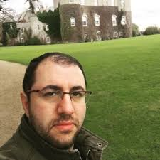
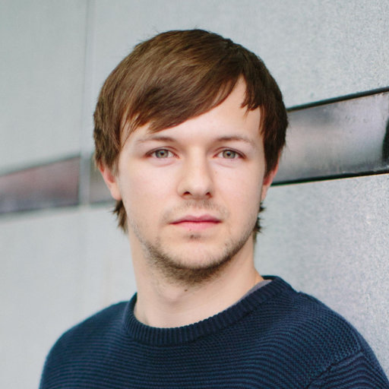
Computational Neuroscience and Neuromorphic Engineering Team (CNET)
Prof. L. McDaid Dr. J. Wade Dr. B. Flanagan M. Toman A. Poshtkohi
Prof. J. Harkin Dr. J. Liu M. McElholm Dr. G. Martin Dr. S. Karim K. Madden

Slide 37
Questions

